Slide 1

UCLA HEALTH · RONALD REAGAN MEDICAL CENTER
Knowing the Patient
Developing an ICU-Adapted Humanistic Charting Tool
A qualitative needs assessment of personhood documentation in critical care
Christopher Montgomery, MD, MPH
Emergency Medicine, UCLA · Faculty sponsor: Nida Qadir, MD · IRB-26-1142
Palliative Care Research
Work-in-Progress Seminar · 9.3.2026
Notes:
Work in progress — hoping to use the discussion to make it better. 30 seconds here.

Slide 2
THE PROBLEM
The information exists. The infrastructure doesn’t.
Who a patient is — baseline function, minimum acceptable quality of life, who truly speaks for them — is collected every day, by physicians, nurses, social workers, and case managers. But it is collected at exorbitant effort, because nothing in the system expects it the way the system expects a basic metabolic panel. So it arrives inconsistently, redundantly — and often only after a palliative care consult finally assembles it.
A lab value — ordered → drawn → resulted → trended. Consistent, expected, automatic: the system does the work.
Who the patient is — asked when someone fights for it → held in one clinician’s head → re-asked by every role → lost at handoff. The people do the work.
“I believe anyone living with a chronic, impactful condition deserves what palliative care provides. Most will never get the consult — there aren’t enough of you. So the question became: can we extend the reach of what this field does?”
Notes:
Correcting the usual framing: it's not that this information is missing — it IS collected, but at huge human cost, because the system never made it expected the way labs are expected. Then the personal belief: democratizing what palliative care produces.

Slide 3
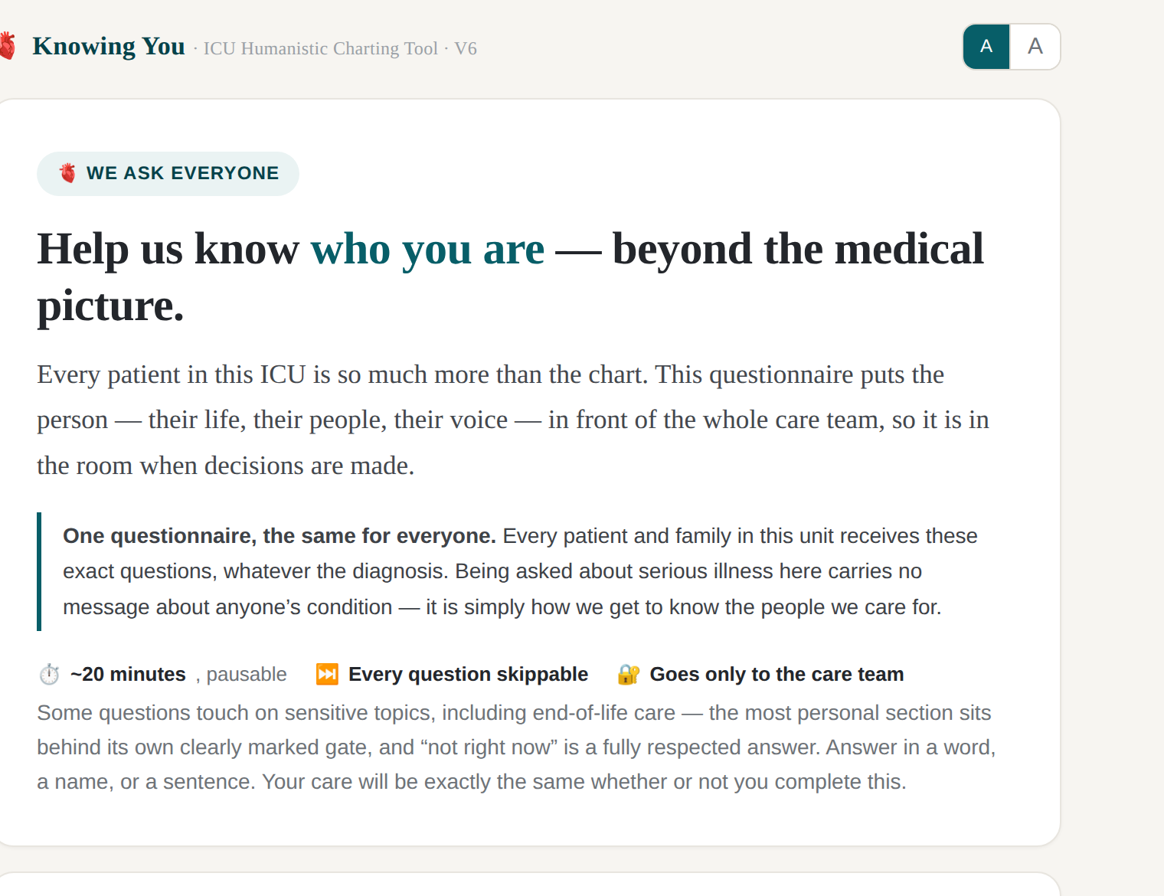
ORIGIN & APPROACH
Built with the people who will live with it
🫀
Lineage
The Humanistic Charting Tool: a structured home for who the patient is, alongside what they have. ED pilot published in JACEP Open, 2025.
🏗️
The ICU is different
Patients often cannot speak; surrogates carry the weight; stakes and timelines change. So the adaptation began by asking the ICU workforce itself.
🤝
Community-based participatory research
Instruments designed with their users work better than instruments designed for them — and collective ownership is what makes adoption real, not mandated.
🧭
The needs assessment is the design process
Every structure you’ll see — the questions, the gate, the views — was derived from what informants taught us, not drawn at a whiteboard.
“We ask everyone” — one questionnaire, the same for every patient and family, whatever the diagnosis.
Notes:
HCT lineage in one breath. CBPR is a genuine commitment, for two stated reasons: effectiveness and buy-in. The screenshot shows the tone the tool takes with patients.

Slide 4
THE STUDY
Three aims
1
2
3
What is essential
Which personhood information matters in the ICU — and which decisions it informs.
What happens now
How that information is currently captured, shared — and lost.
What to build
Design requirements for an ICU-adapted Humanistic Charting Tool.
Notes:
Fast. The third aim is the destination — that's why it's the dark card.

Slide 5
METHODS
Derived from the workforce, not invented
15
4
~865 → 50
8
key informants
UCLA RRMC medical ICU
role strata
physicians · nursing · social work · case management (PT/OT pending)
codes
initial codes distilled to 50 focused codes
categories
constant comparison · deviant-case analysis
Constructivist grounded theory (Charmaz). Purposive sampling across role strata; iterative coding with constant comparison and deviant-case analysis; saturation assessed per stratum — reached in nursing. Everything on the next five slides traces to this corpus.
Notes:
One breath. This slide certifies that the tool's structure was derived, then move on — the tool itself is the point.

Slide 6
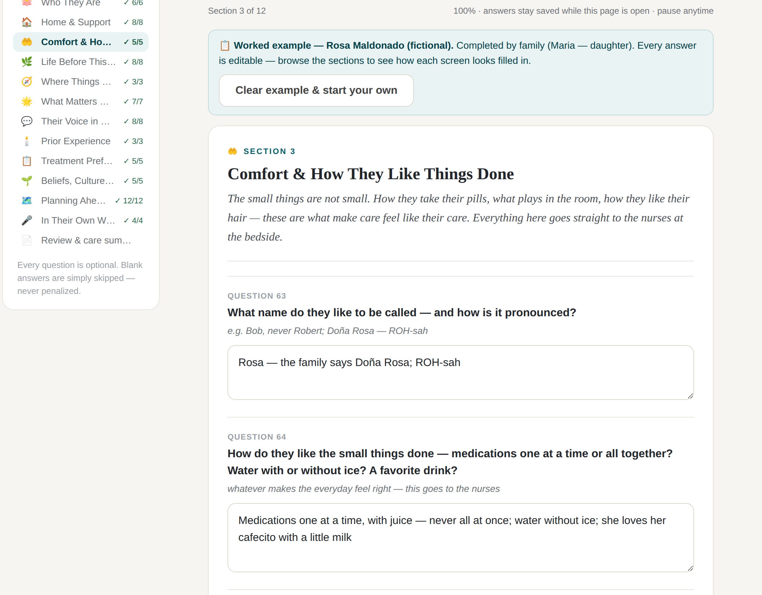
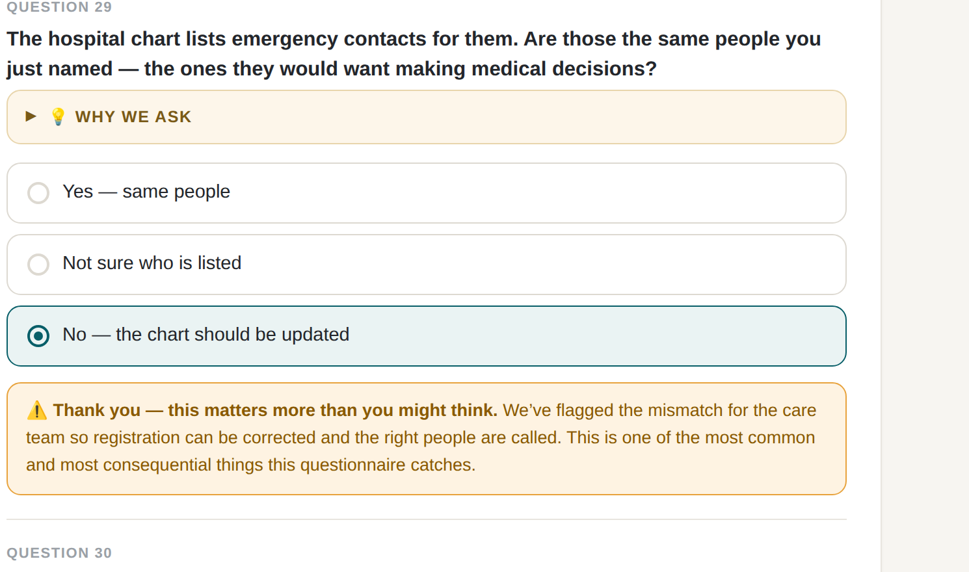
INSIDE THE TOOL · 1 OF 4
How it asks
Direct, open-ended, plain language. “What name do they like to be called — and how is it pronounced?” Answers in a word, a name, or a sentence. Every question skippable, never penalized.
“Why we ask,” on the question. Sensitive items carry their own transparent rationale — the answer never changes the care provided.
It catches real things. Emergency contacts vs. the people they’d actually want deciding — a mismatch the tool flags for the team the moment a family notices it.
The surrogate-mismatch catch, live in the worked example.
Notes:
Rosa Maldonado worked example — fictional teaching case. Left shot: Q29 catches that the chart's emergency contacts aren't the people the patient would want deciding, and flags it. Right: the Comfort section — micro-preferences that go straight to the nurses.

Slide 7
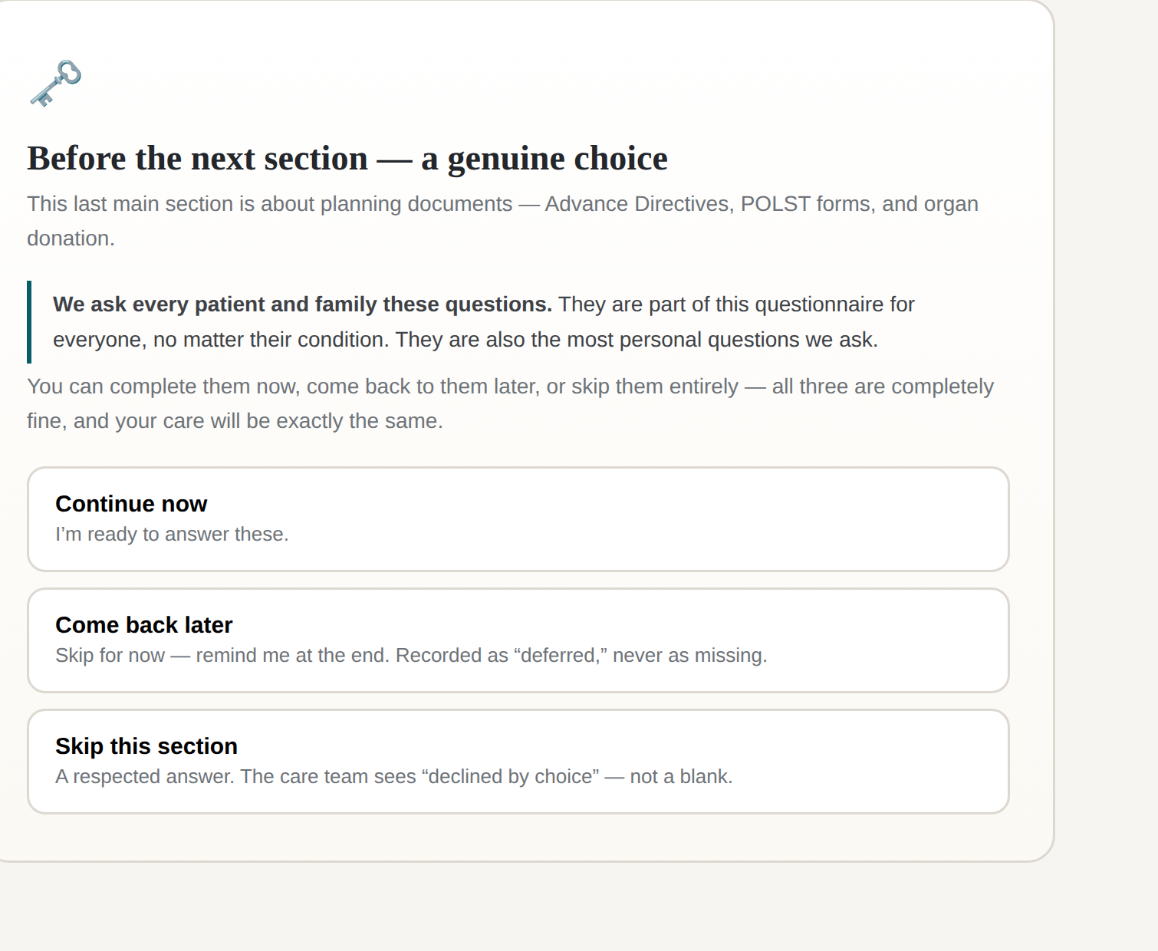
INSIDE THE TOOL · 2 OF 4
In the patient’s corner — by design
No new burden on the workforce. Completion sits with patients and families — in the waiting hours ICU families have in abundance. The team engages with the output, not the intake.
Entirely optional. If they want to fill it out, they can. If they don’t, they don’t — and care is exactly the same.
The most personal section is a genuine choice. Planning Ahead sits behind its own gate: now, later, or not at all.
Deferral is data, never a blank. “Come back later” is recorded as deferred; “skip” as declined by choice. Readiness has its own timeline — the record respects it.
The Planning Ahead gate — three answers, all respected, all recorded.
Notes:
Answer the burden question before anyone asks it. Patient/family empowerment framing: they become contributors to the chart. The gate embodies the design philosophy — informants taught us readiness has its own timeline.

Slide 8
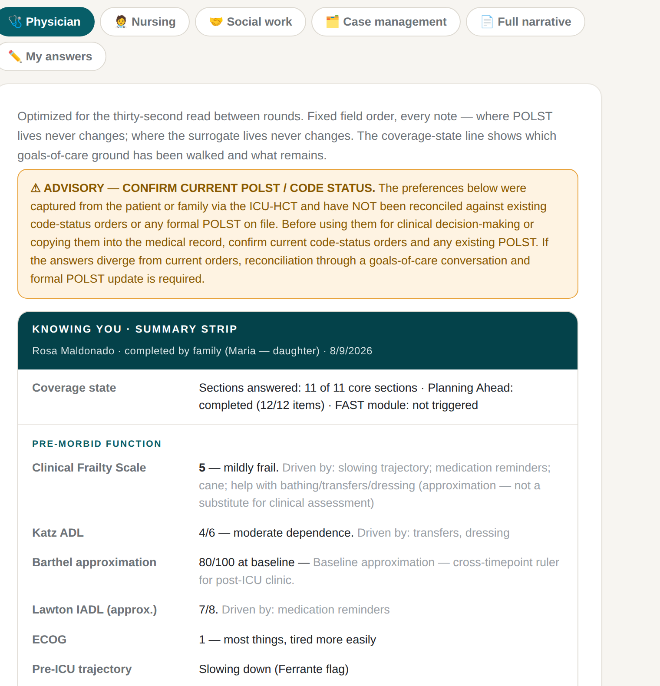
INSIDE THE TOOL · 3 OF 4
How it maps: story in, structure out
Open answers on the surface, AI mapping underneath. Free-text stories about daily life are mapped onto validated instruments — Clinical Frailty Scale, Katz, Barthel, Lawton, ECOG approximations.
Drivers stay visible. Every derived score shows exactly which answers produced it — and is labeled an approximation, not a substitute for clinical assessment.
Nobody fills out a Barthel. The Barthel emerges from the story. Narrative and quasi-objective structure from a single capture — you don’t choose between them.
Consistent like a panel. Fixed sections, fixed order, fixed summary strip — clinicians find the surrogate the way they find a potassium.
Notes:
The method that sets this apart. Pre-morbid function block of the physician summary strip: CFS 5 with drivers listed, Katz 4/6, Barthel 80/100 baseline, Lawton 7/8 — each traceable to the family's own words. Note the POLST reconciliation advisory above it.

Slide 9
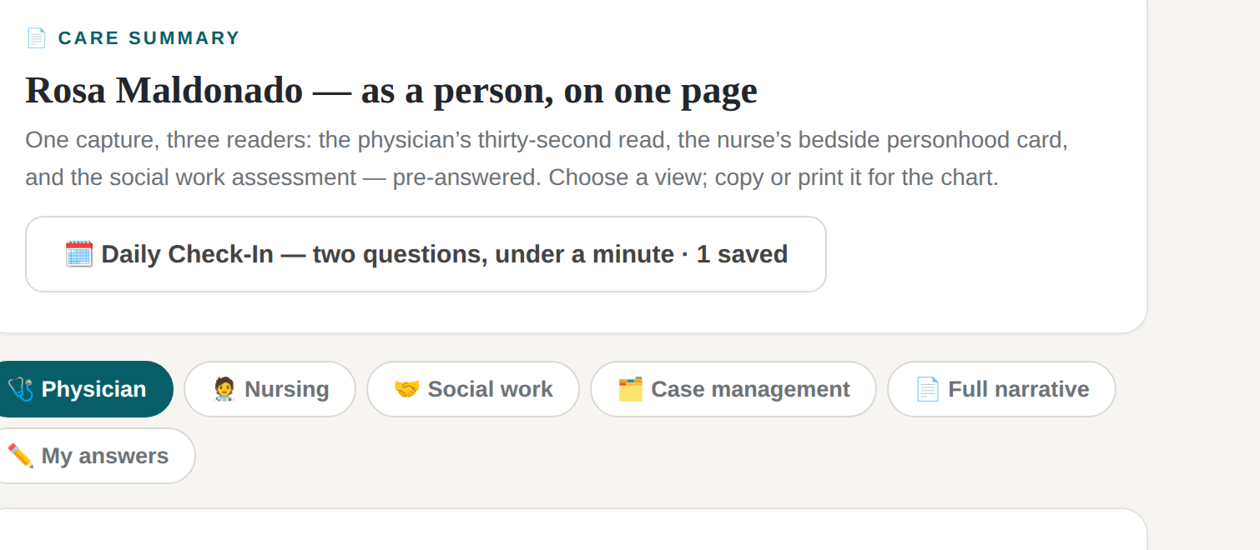
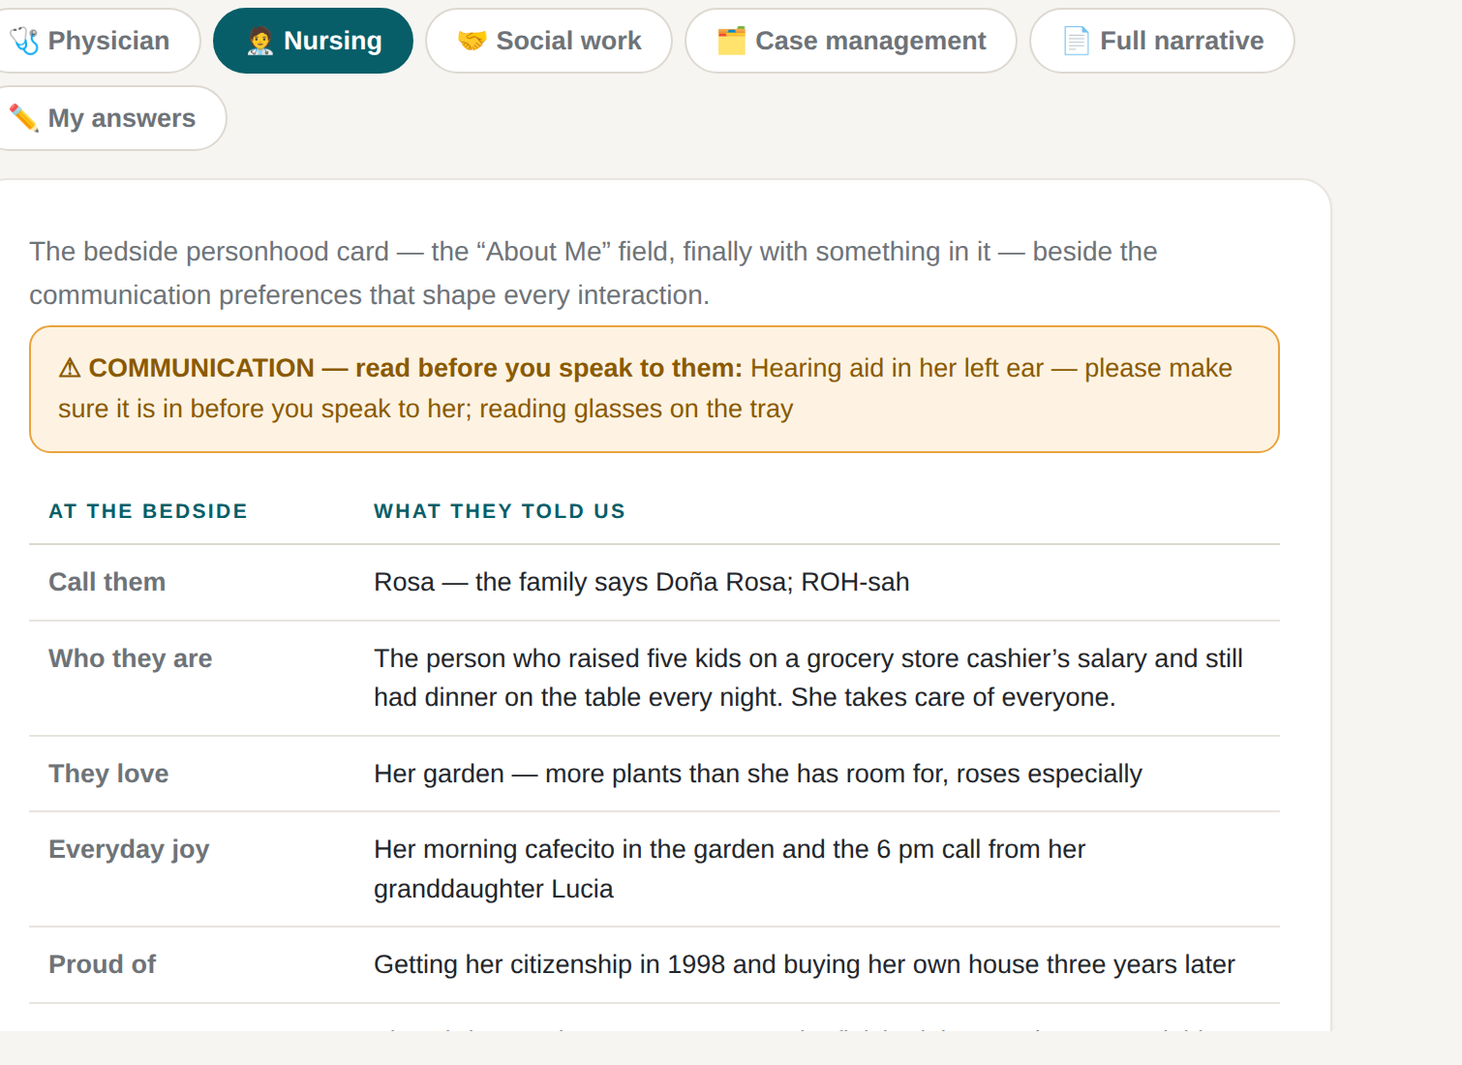
INSIDE THE TOOL · 4 OF 4
One capture, many readers
Role-distributed views. Physician, nursing, social work, case management — the same capture, pre-arranged for each reader’s thirty seconds.
Dosed, not dumped. The physician view opens at a one-line read; depth is on demand. Informants were precise about how much personhood data a clinician can absorb — the tool doses it.
Guard-railed. Preferences are never chart-ready orders: a standing advisory requires reconciliation against current code status and POLST.
“The ‘About Me’ field — finally with something in it.”
Notes:
Top: the review screen with the six view tabs. Bottom: the nursing bedside personhood card — communication warning first (hearing aid, left ear), then who Rosa is: raised five kids on a cashier's salary, her garden, her cafecito, the 6pm call from Lucia.

Slide 10
WHAT THIS IS — AND ISN’T
It does not replace the conversation.
It extends its reach.
For the patients who never get the consult — most people living with serious illness.
For the days before the consult arrives — so the specialist starts from a populated picture, not a blank one, and the first twenty minutes aren’t inventory.
For the handoffs where beautiful information dies — captured once, structured where it can be, narrative where it must be, present at decisions.
Built out of admiration for what those conversations produce — and impatience that so few patients ever get one.
Notes:
The positioning beat for this room. Nothing replaces the palliative care conversation — the tool exists for the gap around it.

Slide 11
NEXT
The pilot: does knowing the patient change care?
ICU Team A
Knowing You offered
Care experience
both sides of the bedrail — incl. feeling known as a person
Benefit to care
perceived value to the work, by role
Paired surveys
patients & families
health care workers
ICU Team B
Usual care
Burnout & fulfillment
does knowing patients as people protect the workforce?
Feasibility & fidelity
completion, deferral patterns — and derived-score concordance vs. formal instruments
Deliberately not chasing mortality or length of stay at pilot scale — process, experience, and workforce measures first; distress around Planning Ahead monitored through the tool’s own deferral data.
The needs assessment told us what to build. The pilot asks whether it changes care. What else should it measure? — that’s my question for this room.
Notes:
Hopeful close. Two-team comparison, paired surveys. If knowing patients as people does what informants say, it should show up in what the work feels like — hence burnout AND fulfillment. End by handing the room the question: what else should the pilot measure?

